Slide 1
Mobile Applications
Group 48 - Campus Event App

Slide 2
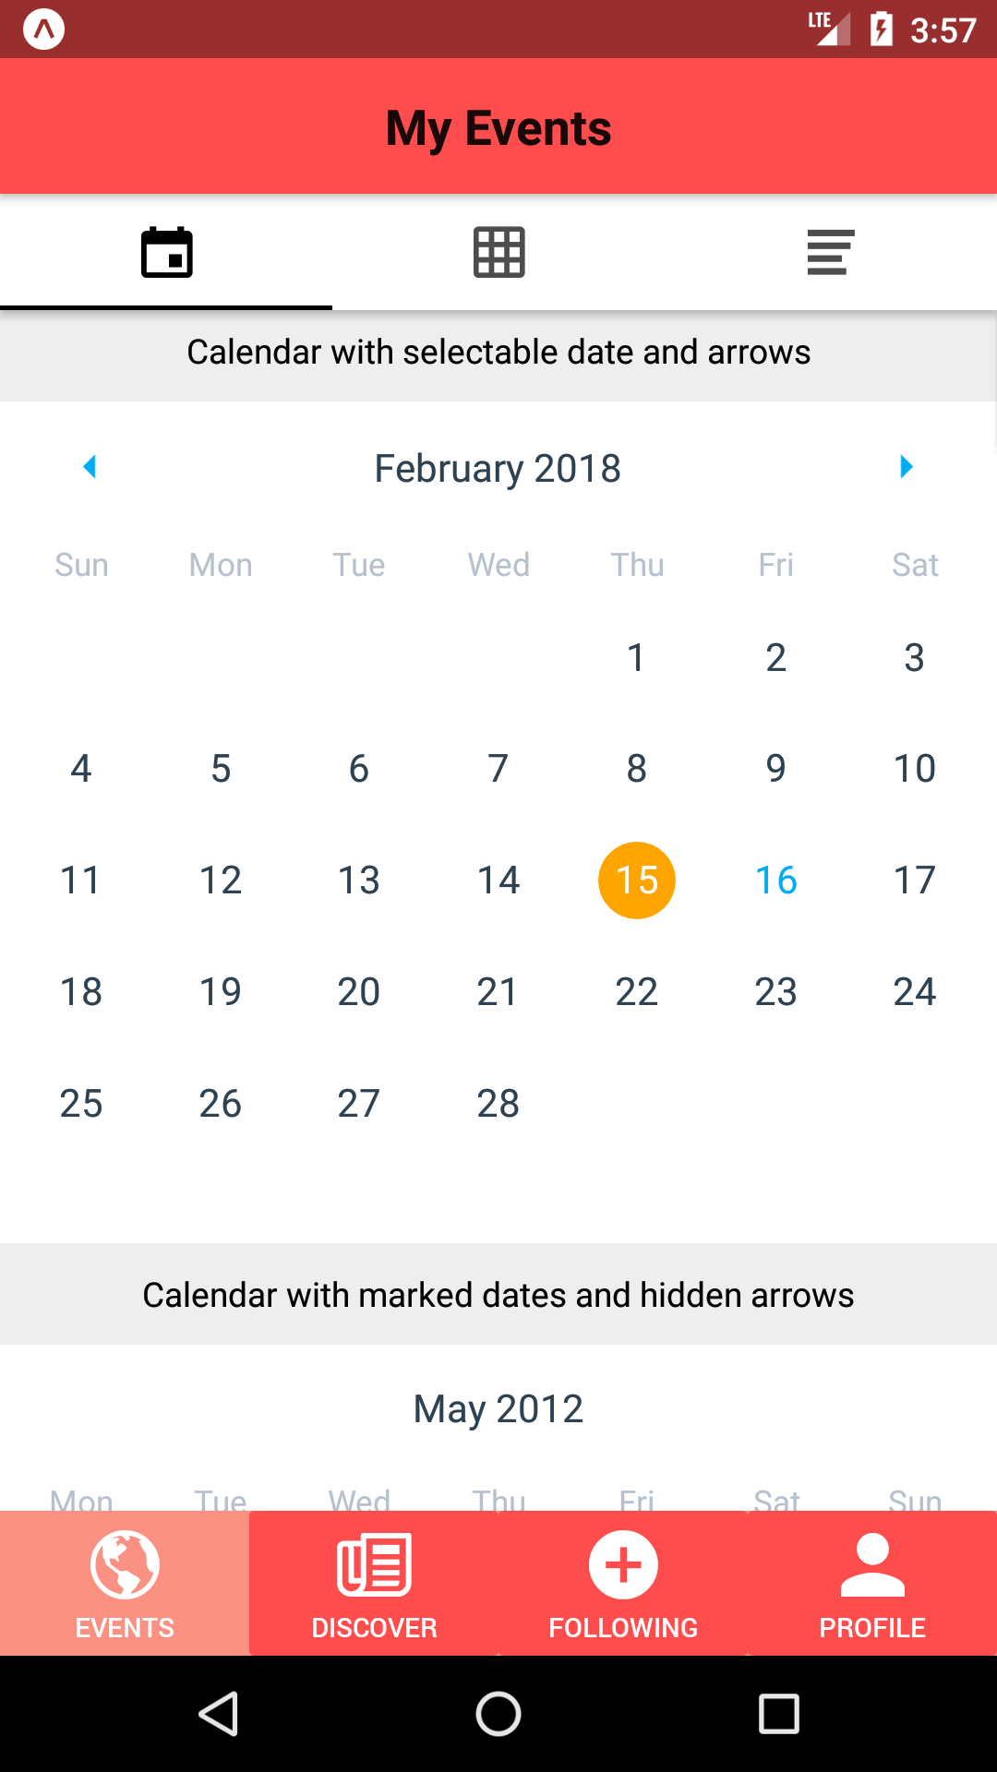
Current progress of project
Four screens: Events, Discover, Following and Profile are all added to index.js.
Events screen contains three tabs: calendar view, box view and list view.
Use getTheme and material to customize themes for the footbar.

Slide 3
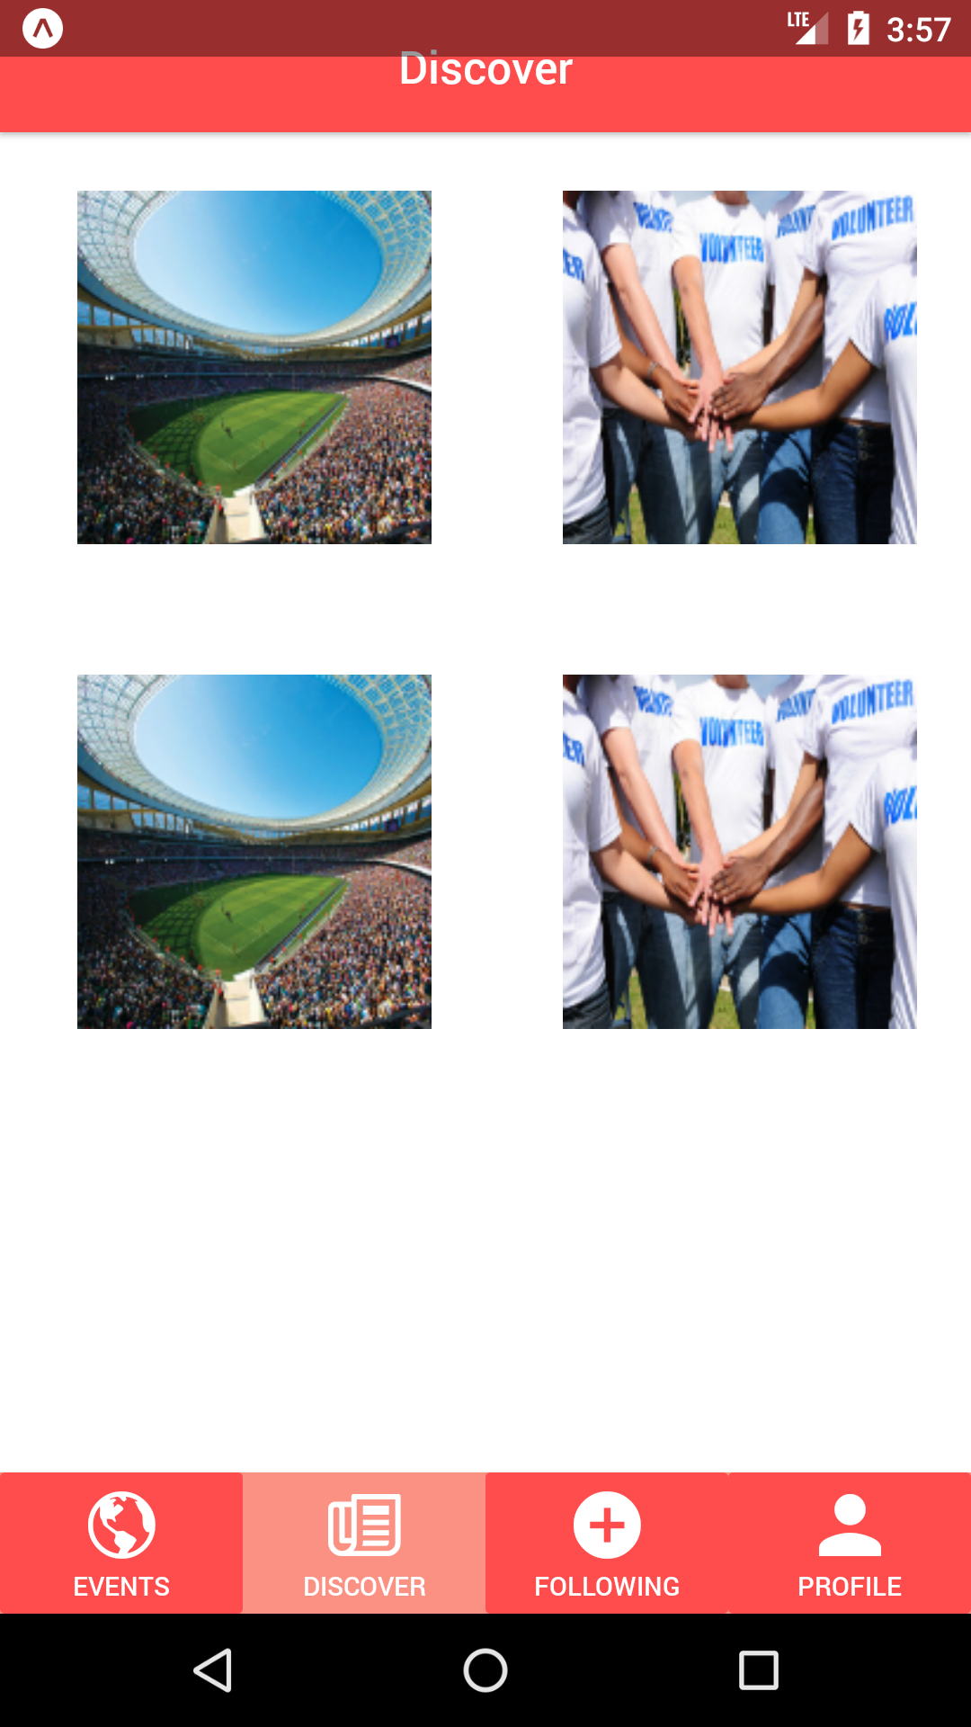
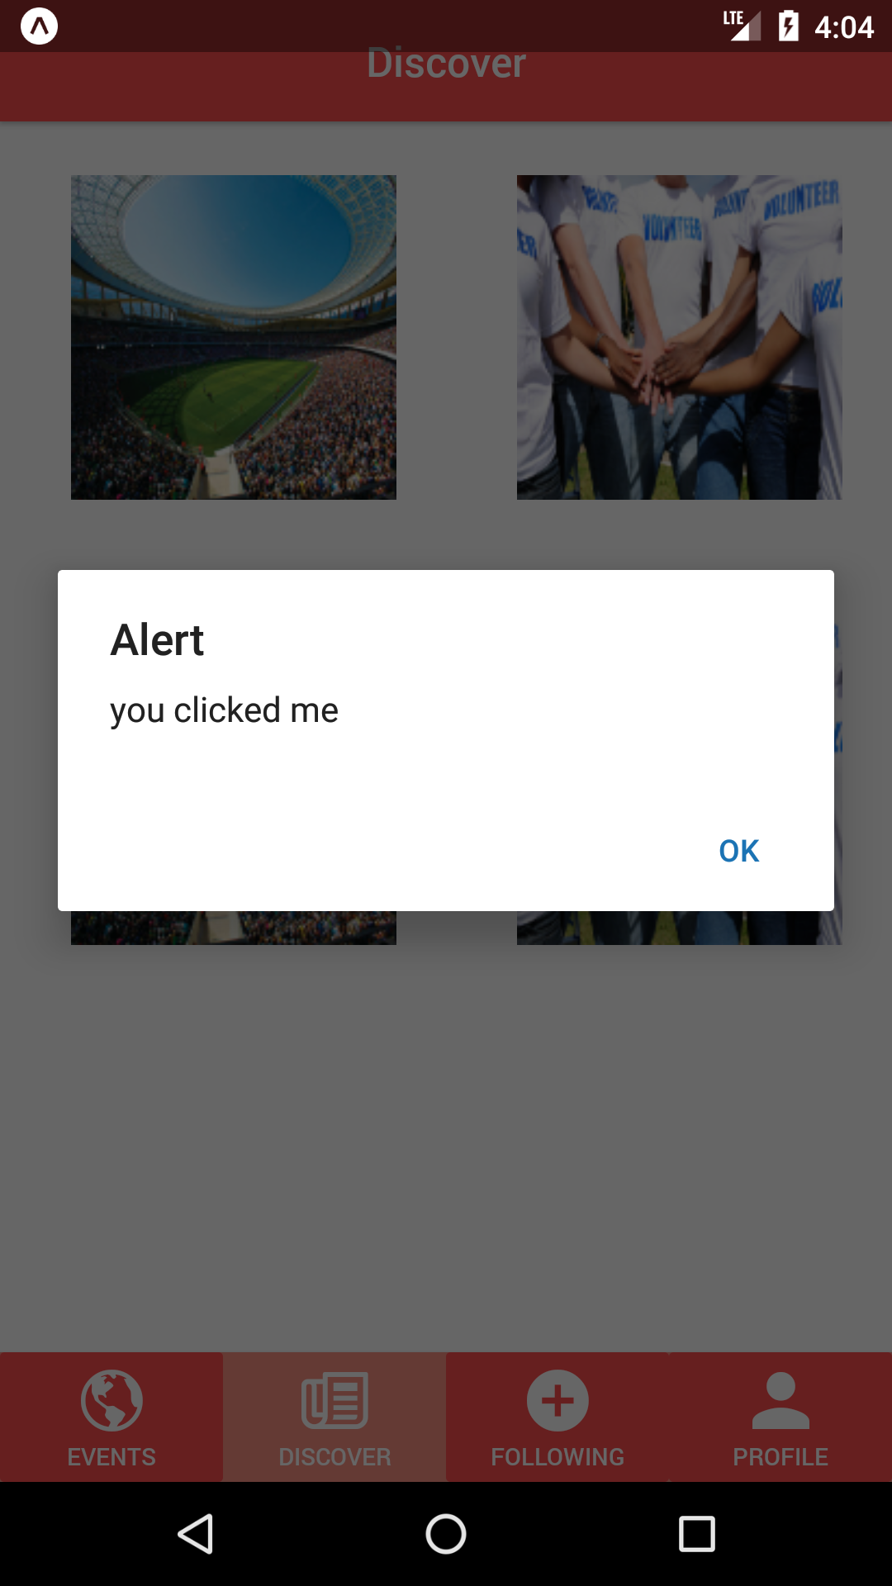
Current progress of project(continue)
Discover Screen contains 4 touchableOpacity objects
Adding 4 images to these 4 objects.
Only a dialogue box will be pop up once click the button.
Need to create more screens and link these screens to correspond buttons.

Slide 4
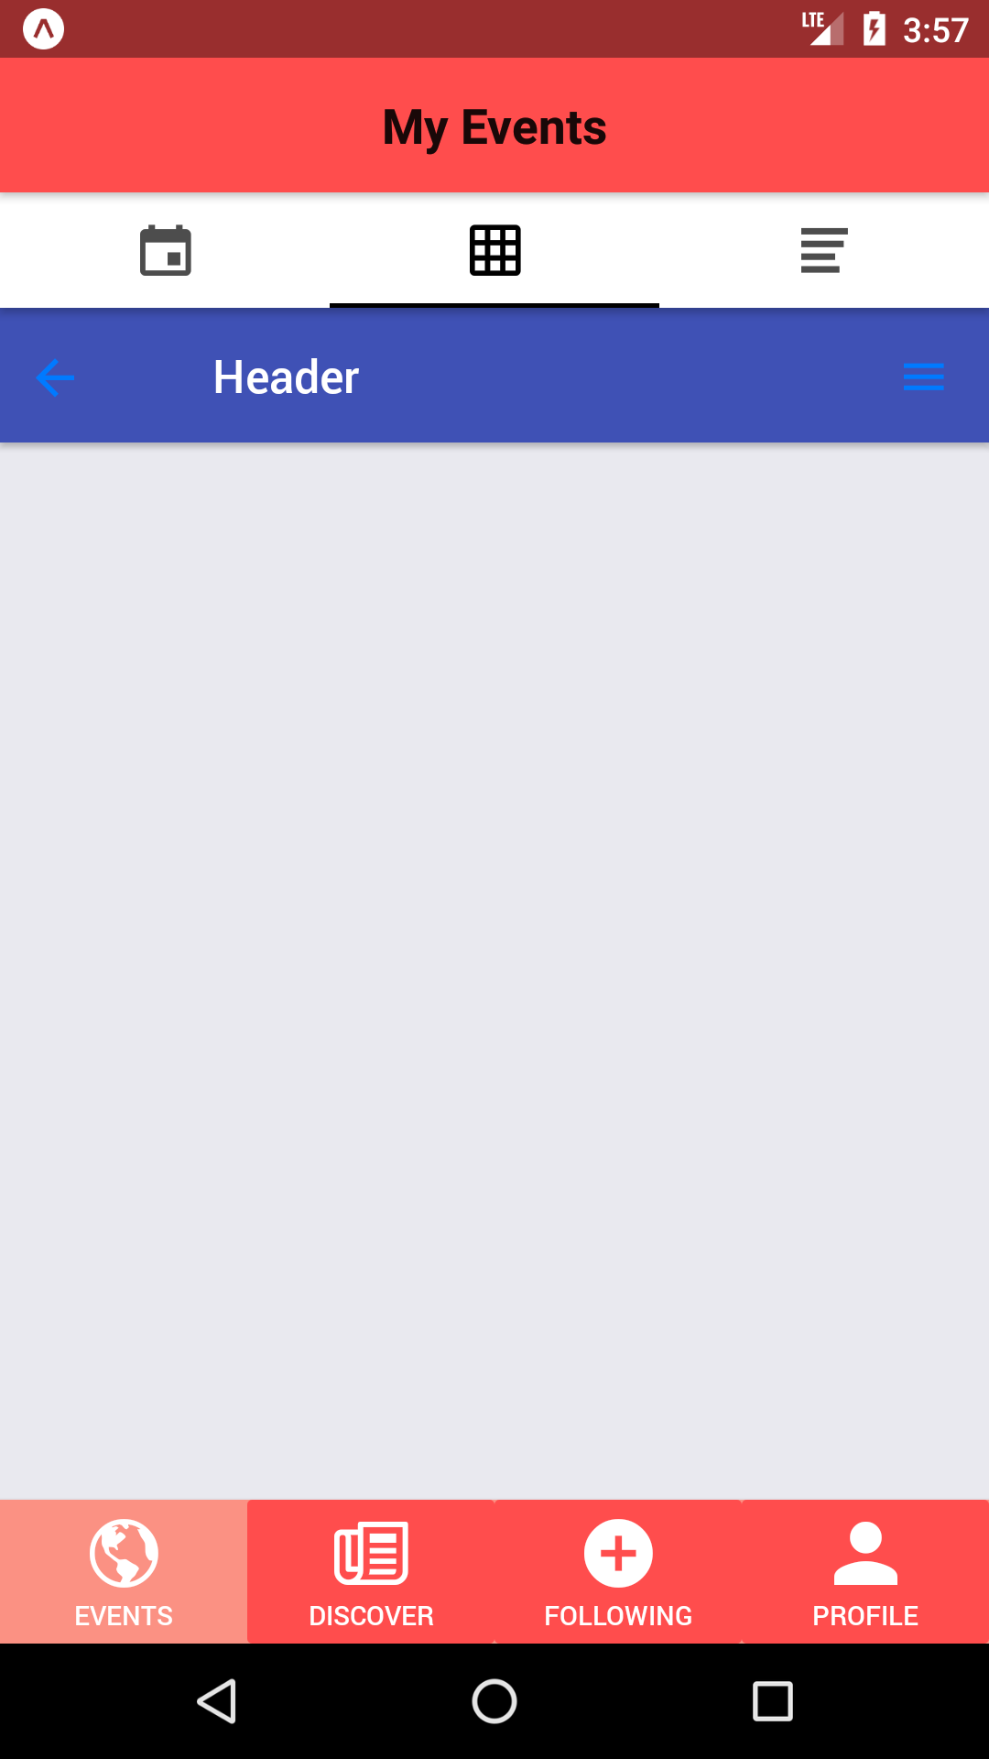
The works that need to be done
Secure Login using oAuth 2
Linking the application to database to retrieve data.
Creating more screens for the mobile application

Slide 5
Problems encountered
No experiences for using React Native
Wired problems encountered during development

Slide 6
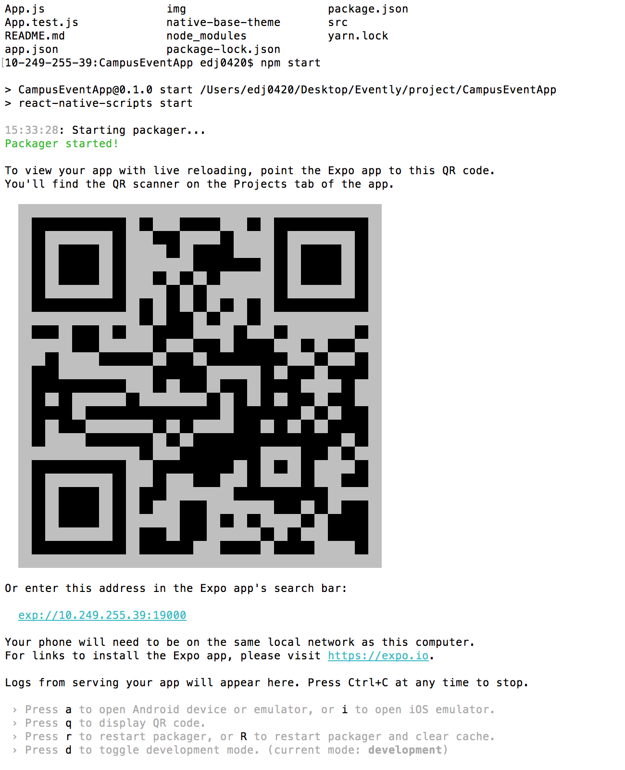
IOS testing
The React Native could work on macOS
By some easy step on terminal to open them
It opens by using Xcode IOS Simulator

Slide 7
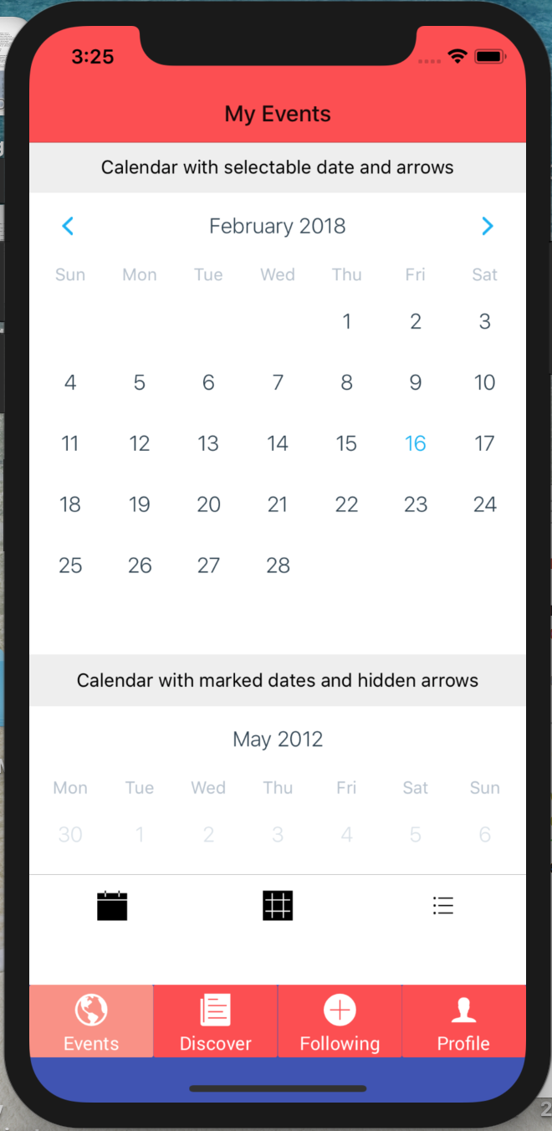
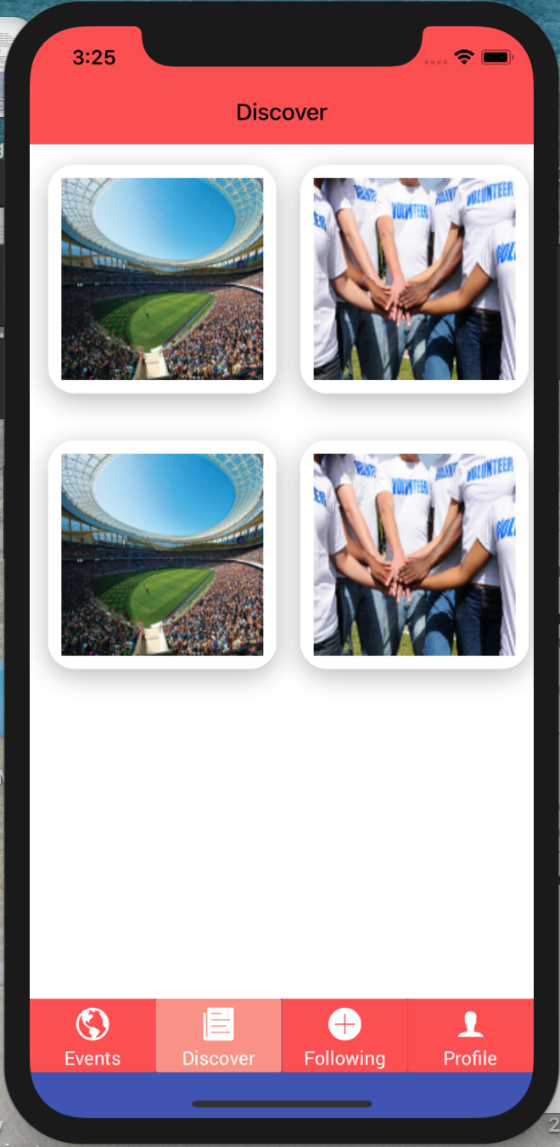
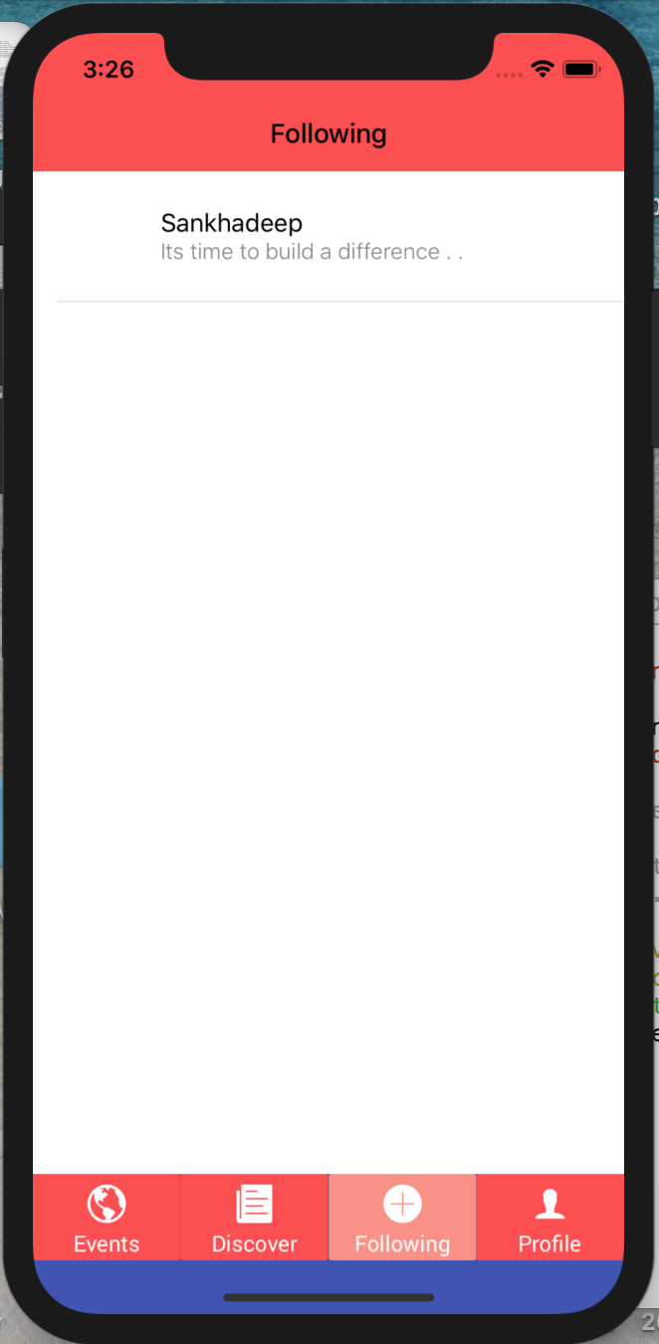
The IOS interface
The functionality is same right now
The interface is same

Slide 8
Problem and left
No experience about React Native either, should set up for Xcode
There have some small thing should to fix on the bottom of IOS interface
Some functionality not be developed yet

Slide 9
Web browser development
The web browser development is one of our goals
The development is now preparing for temporary
By using the HTML, CSS, JavaScript and PHP
Database should be connected to app by using SQL
The web browser development is not a requirement.

Slide 10
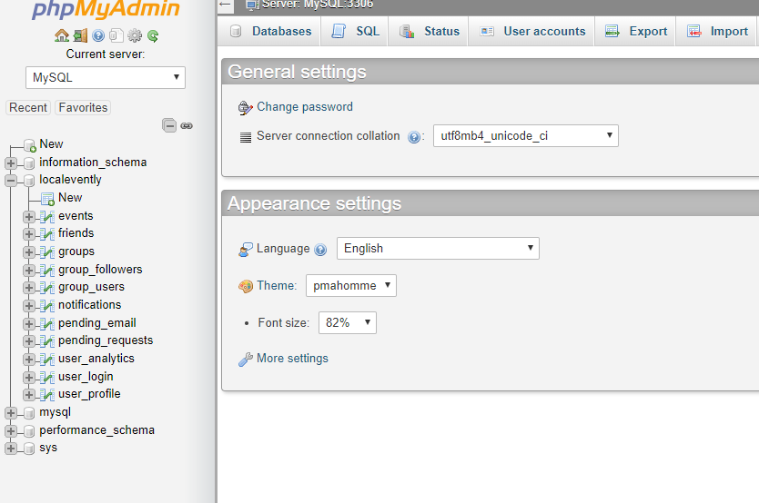
Current Progress
Local database has been created
Created some tables
Placed dummy Data in user_profile

Slide 11
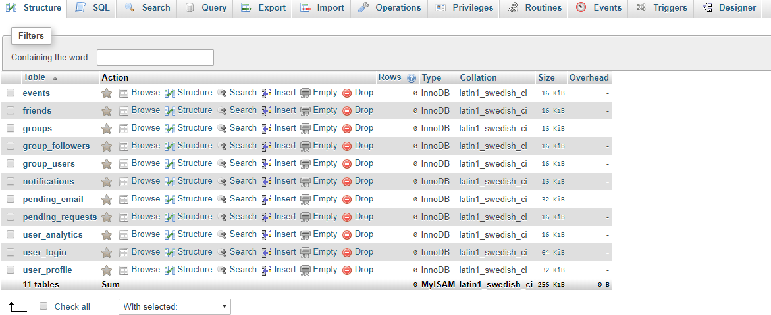
What’s Left?
Connect the database to the application
Add more entities into multiple tables
Finish up the user interface

Slide 12
Problems and Issues
No centralized database
Grabbing “Real data from hosts

